Slide 1
FPU and different multipliers topologies

Slide 2
Names | Section | BN | Email | Roles | Time
Abdelrahman Mohamed Salem | 1 | 37 | abdosalm555@gmail.com | FPU, VM , synthesis process, routing process | 5 days
Ahmed Fawzy Mohamed Ibrahim | 1 | 8 | ahmed.fawzy5.5111@gmail.com | Booth algo radix 4 , synthesis process, routing process | 5 days
Youssef Said Ibrahim | 2 | 40 | youssef.ibrahim01@eng-st.cu.edu.eg | Multiplier tree, synthesis process, routing process | 5 days
Fady Adel | 2 | 6 | fady.abdelmassih01@eng-st.cu.edu.eg | Sequential and booth Algo, synthesis process, routing process | 5 days

Slide 3
Verilog (‘*’) version of multipliers
Based on the synthesis tool, it chooses from the library the most appropriate multiplier which fulfills the constraints specified by the end user to achieve the most optimized version of multipliers.

Slide 4
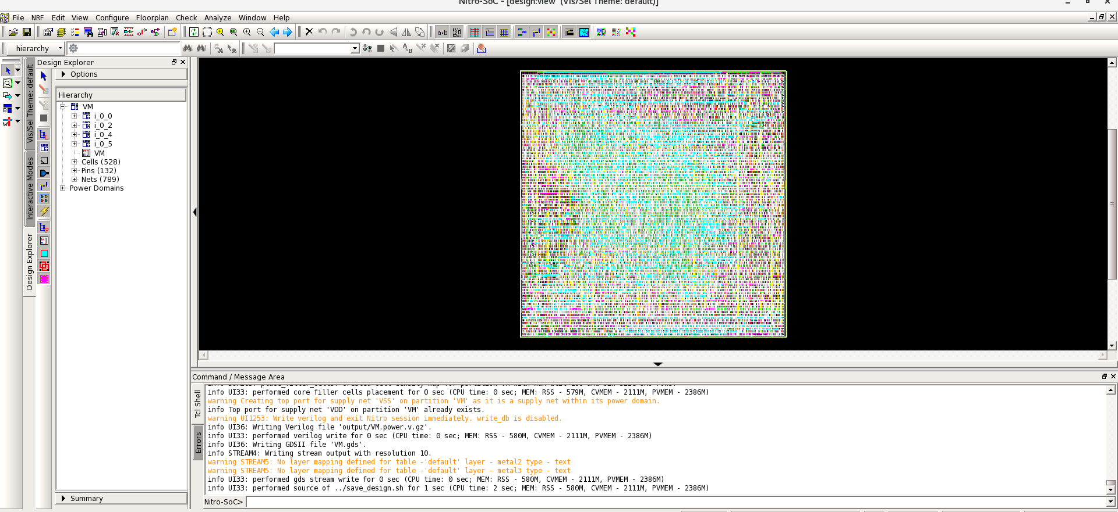

Slide 5
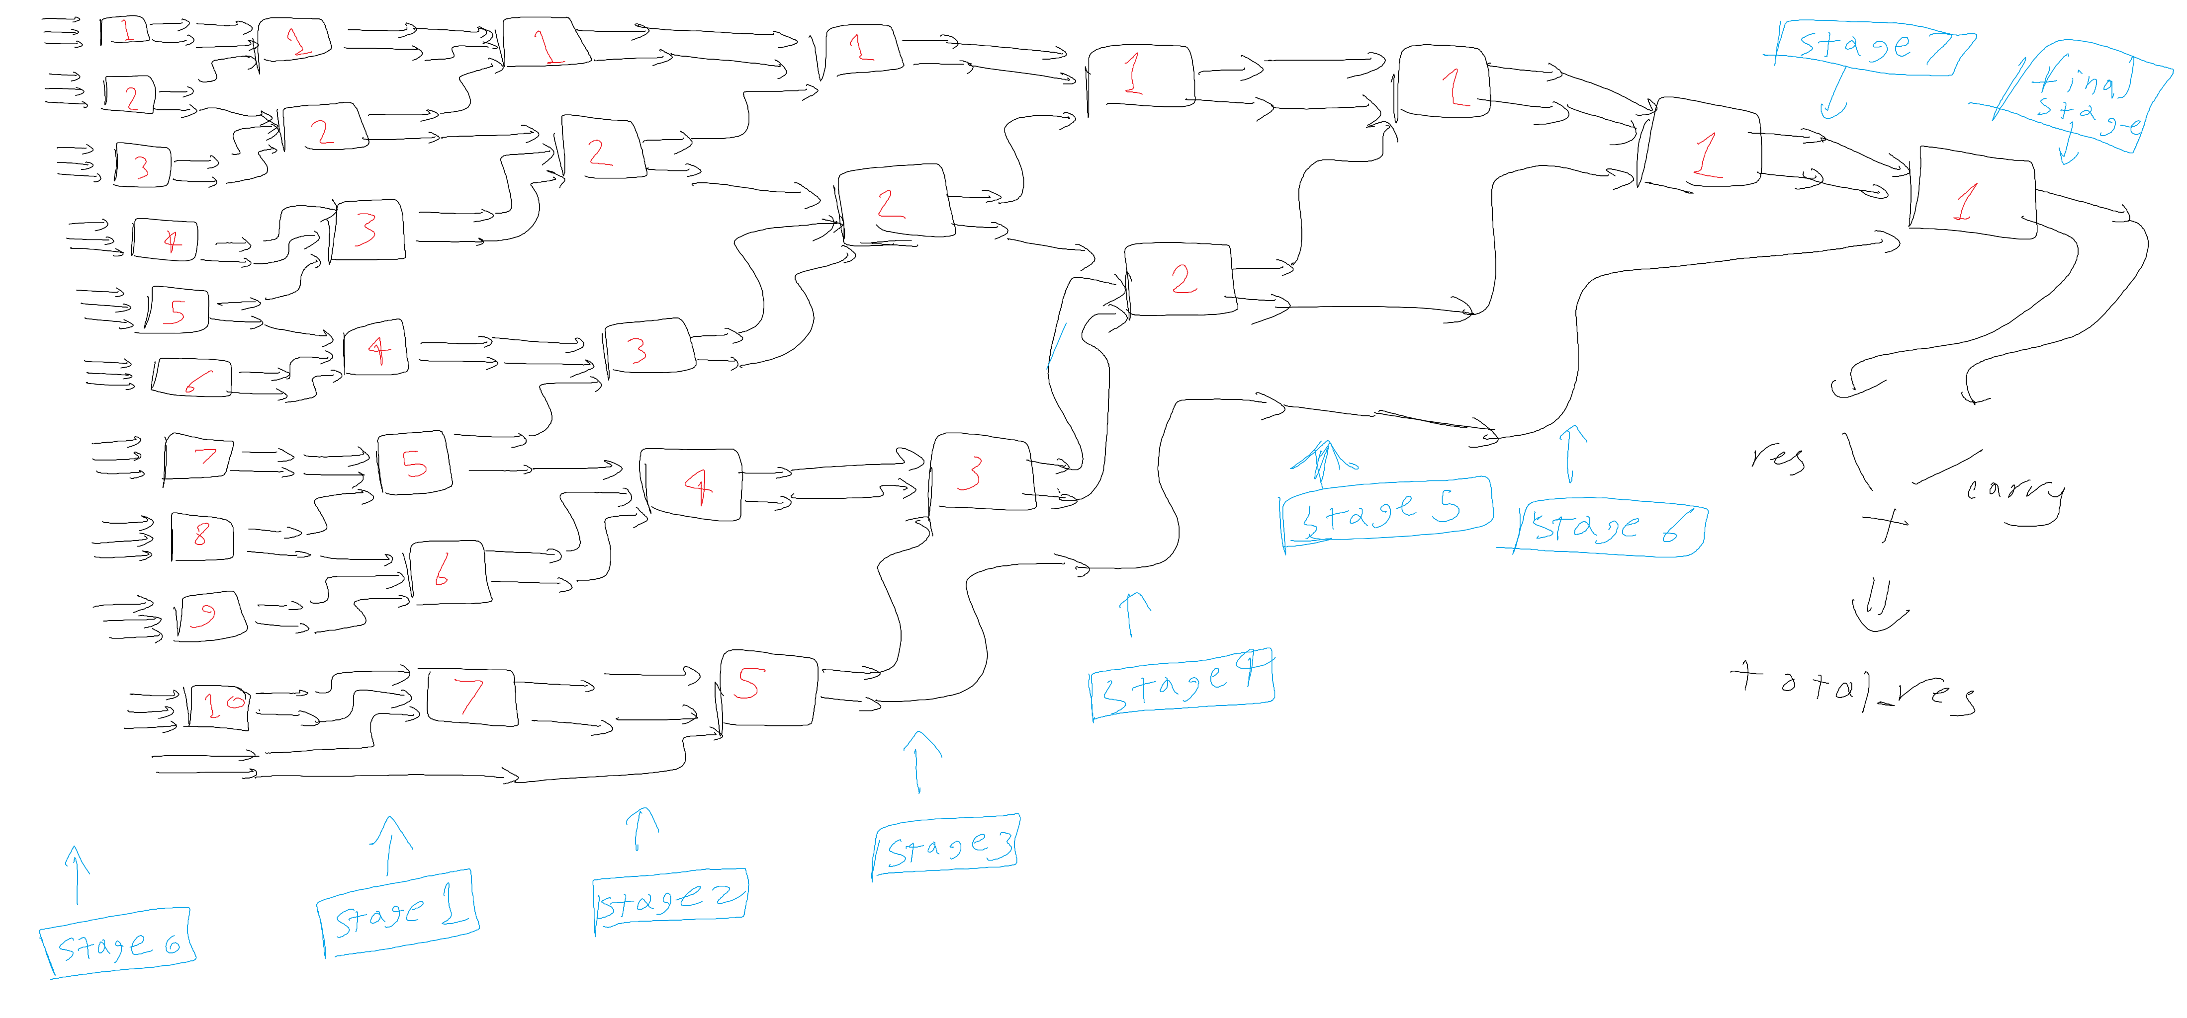
Multiplier Tree (Wallace tree)

Slide 6
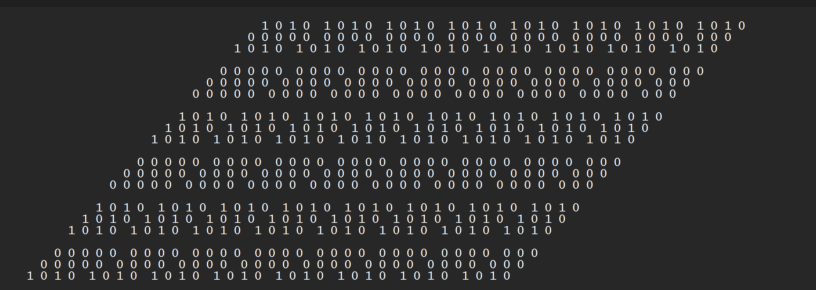
Multiplier Tree (Wallace tree)

Slide 7
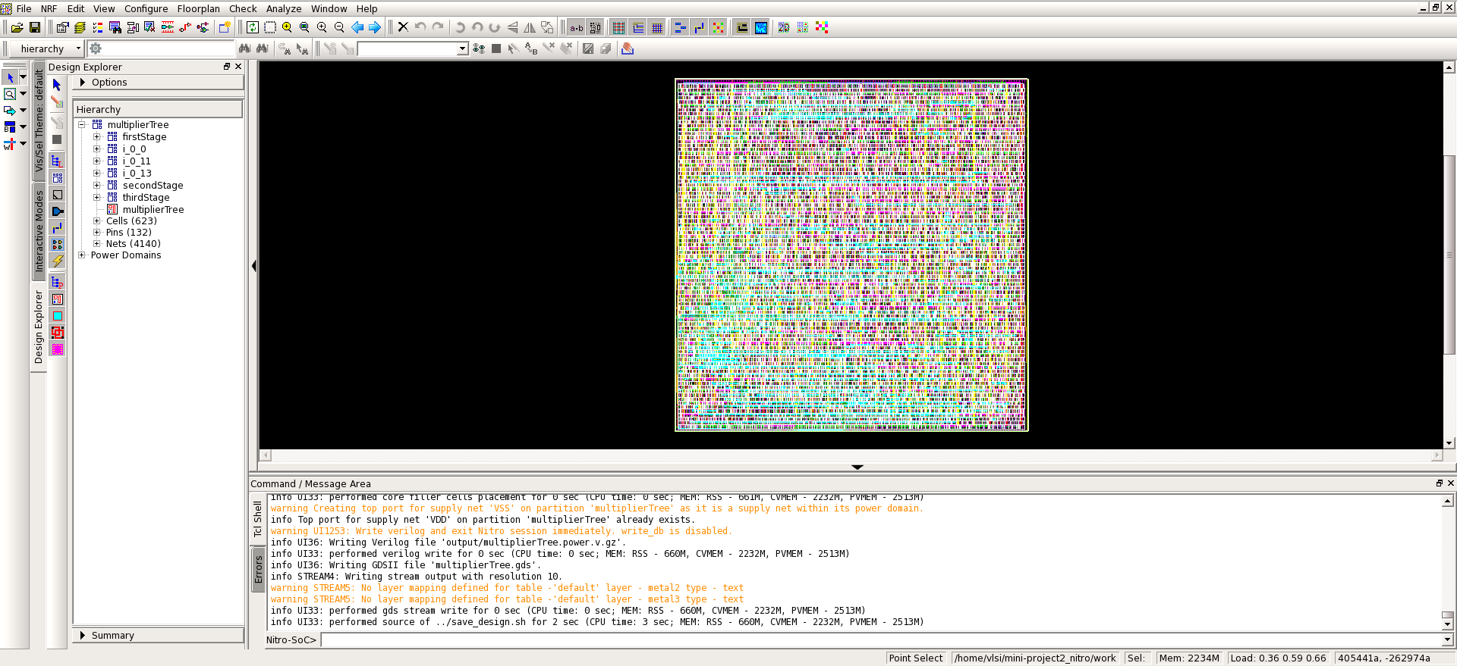
Multiplier Tree (Wallace tree)

Slide 8
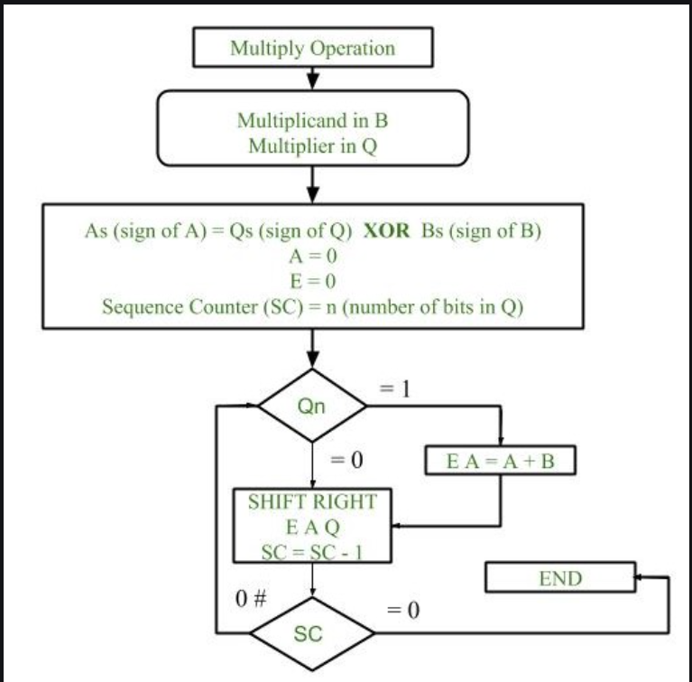
Sequential multiplier

Slide 9
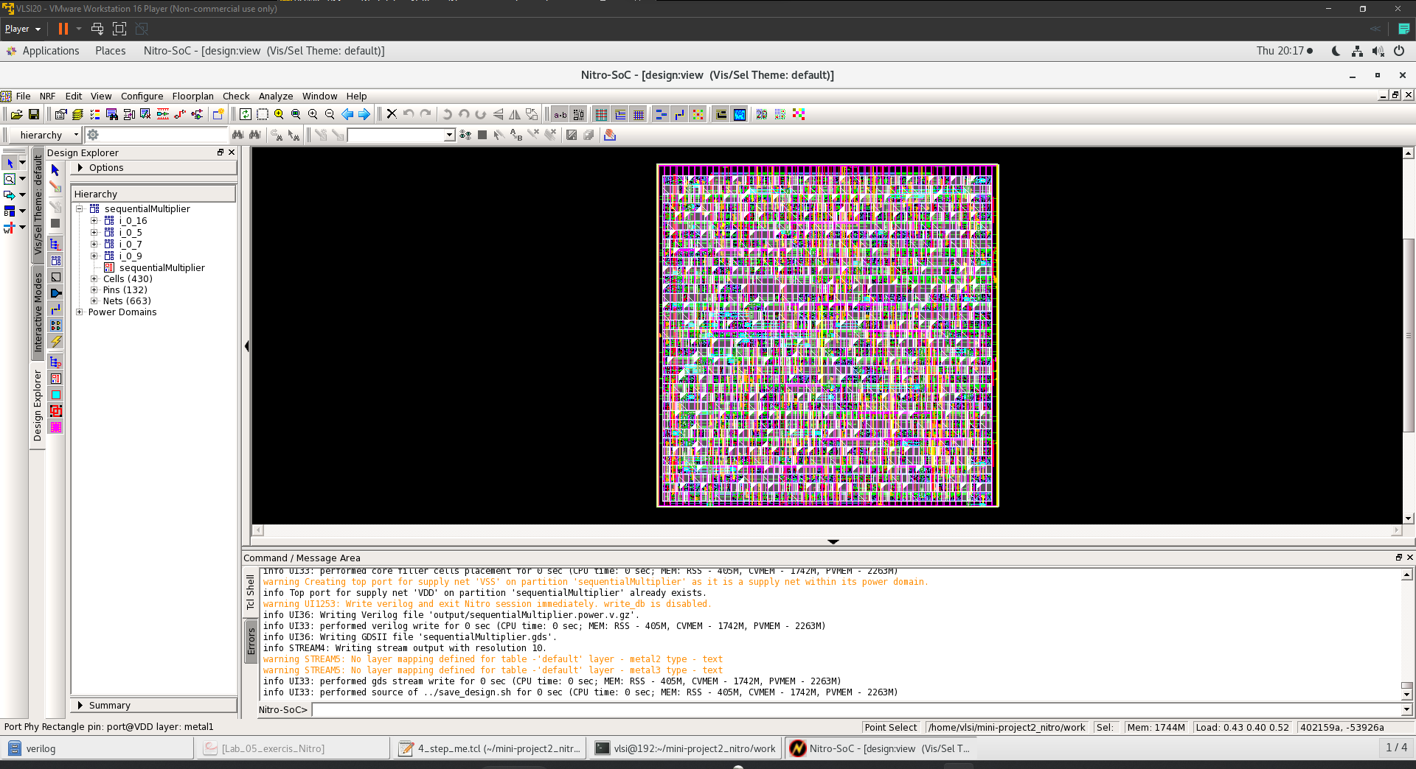
Sequential multiplier

Slide 10
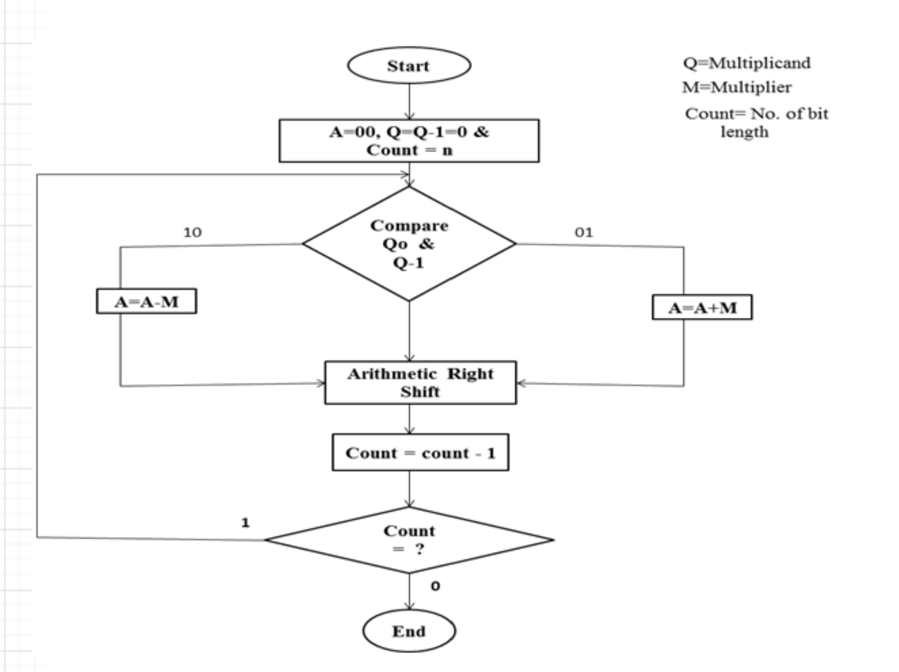
Booth Algo

Slide 11
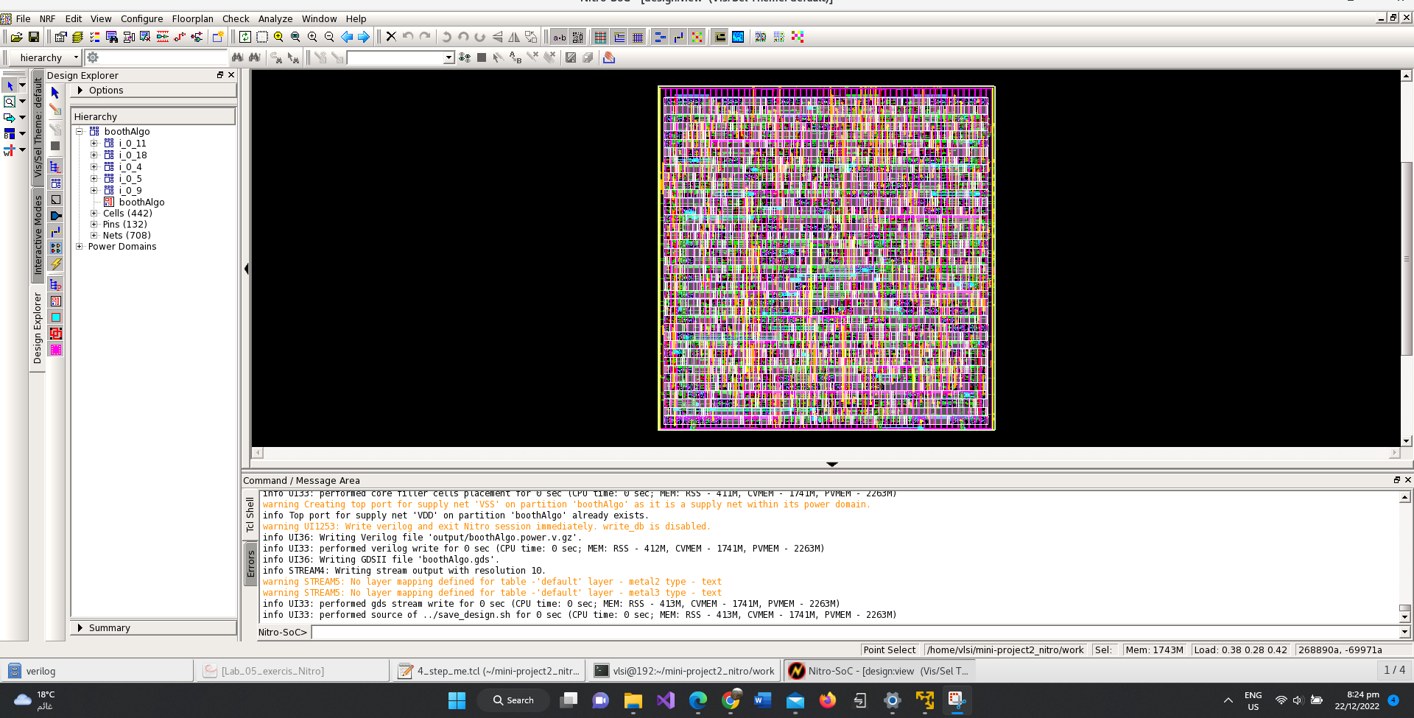
Booth Algo

Slide 12
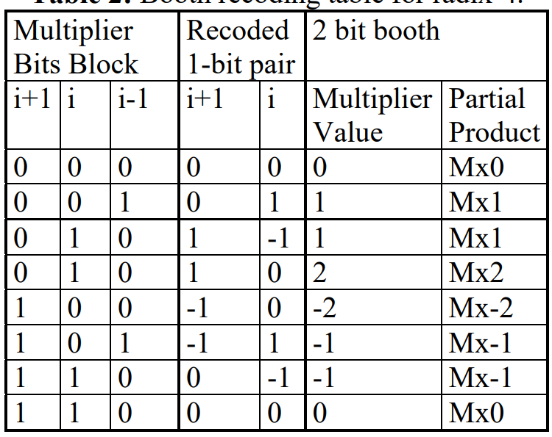
Booth Algo radix 4
Modify one of the multiplicands using the next table.
Same sequence as multiplier but reduced the number of rows by half

Slide 13
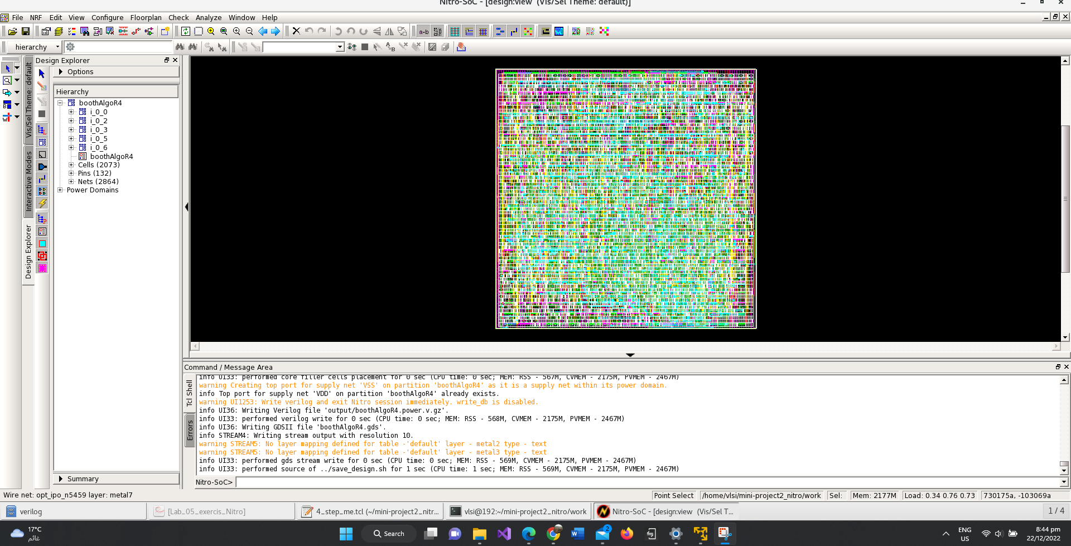
Booth Algo radix 4

Slide 14
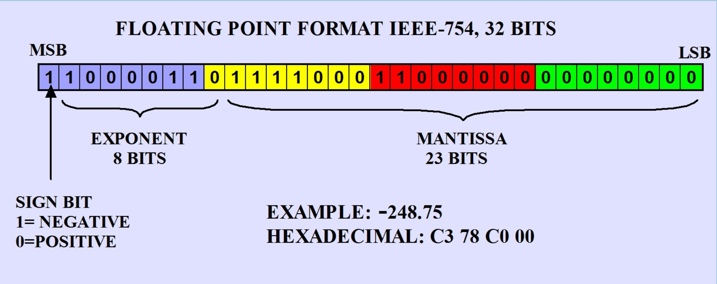
Floating point unit

Slide 15
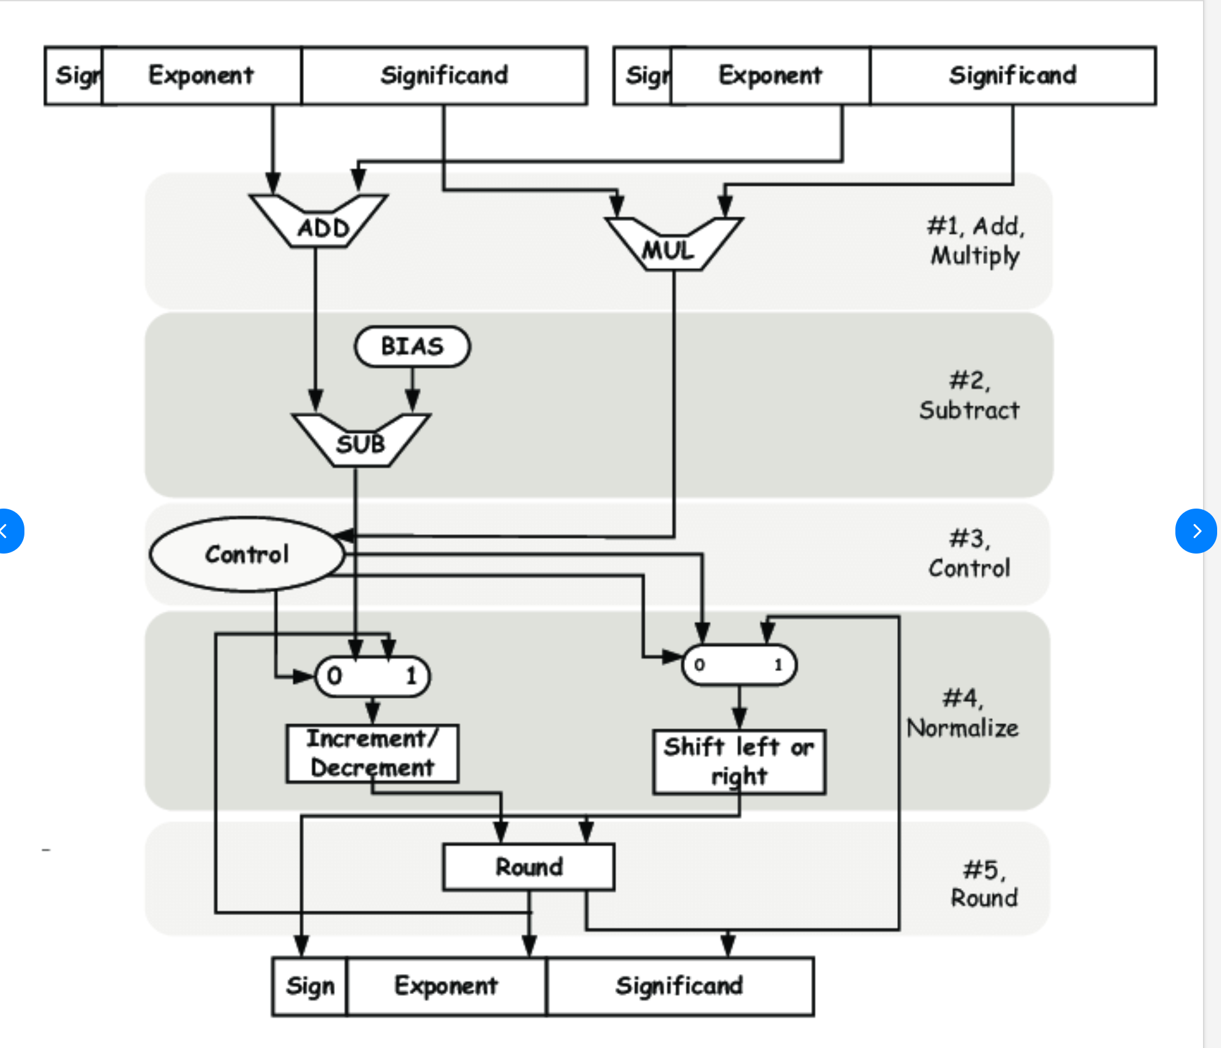

Slide 16
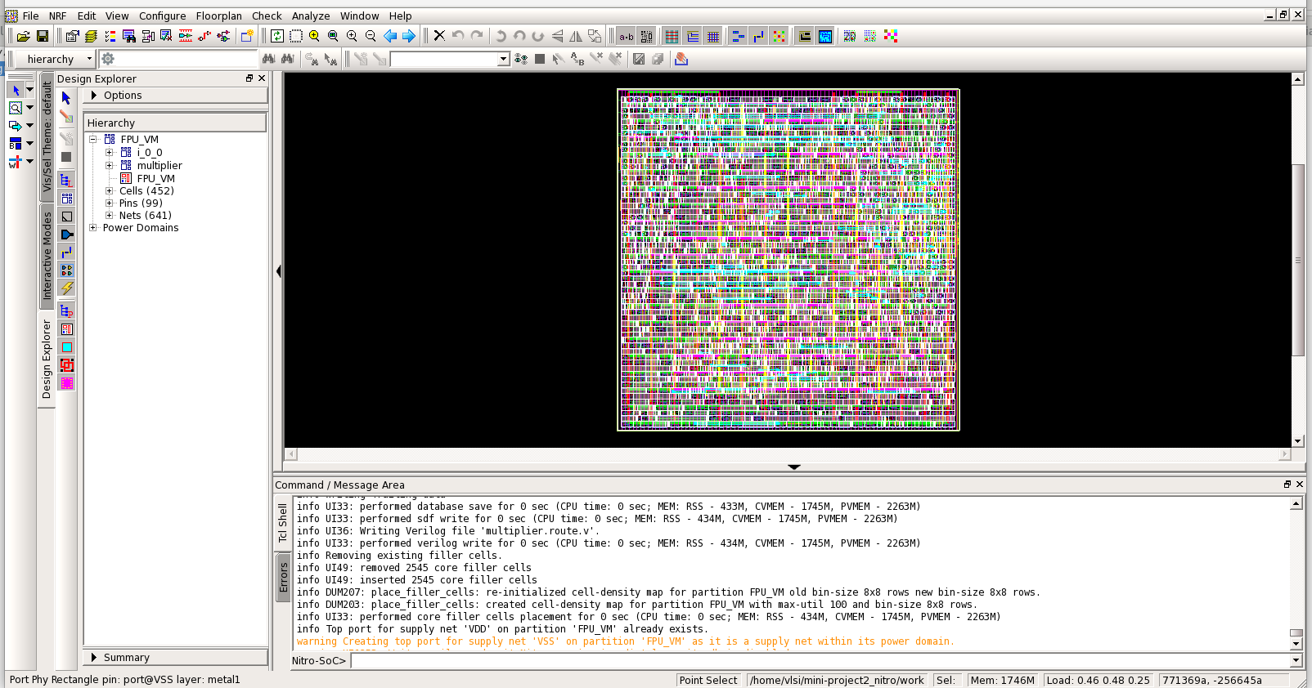

Slide 17
Area

Slide 18
Clock and skew

Slide 19
Data arrival time

Slide 20
utilization

Slide 21
Number of flipflops/latches

Slide 22
Logic depth

Slide 23
power

